Slide 1
Introduction to OpenMP

Slide 2
Can my code be parallelized?
Does it have large loops that repeat the same operations?
Does your code do multiple tasks that are not dependent on one another? If so is the dependency weak?
Can any dependencies or information sharing be overlapped with computation
If not, is the amount of communications small?
Do multiple tasks depend on the same data?
Does the order of operations matter? If so how strict does it have to be?
Notes:
This we can do later

Slide 3
OpenMP introduction
OpenMP stands for “Open Multi-Processing”
OpenMP is a multi-vendor standard to perform shared-memory multithreading
OpenMP uses fork-join model
OpenMP is both directive and library based
Each OpenMP thread has its own stack
OpenMP probably gives you the biggest multithread benefit per amount of work you have to put in to using it

Slide 4
Threads
A thread can be considered to be a lightweight process
A more precise definition is that it is an execution path, a sequence of instructions, that is managed separately by the operating system scheduler as a unit
Threads alleviate the overhead associated with the fork mechanism by copying only the bare essentials needed: the run-time stack
The run-time stack cannot be shared between two threads

Slide 5
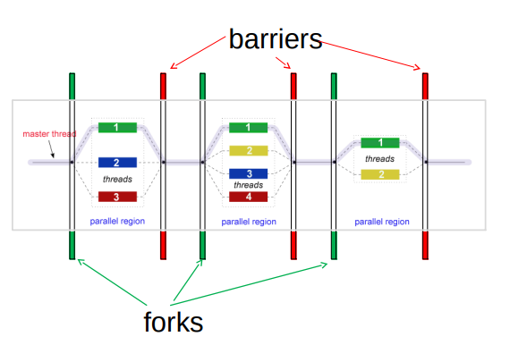
Fork-join model

Slide 6

OpenMP Consortium

Slide 7
What OpenMP Isn’t
OpenMP doesn’t check for data dependencies, data conflicts, deadlocks, or race conditions. You are responsible for avoiding those yourself
OpenMP doesn’t check for non-conforming code sequences
OpenMP doesn’t guarantee identical behavior across vendors or hardware, or even between multiple runs on the same vendor’s hardware
OpenMP doesn’t guarantee the order in which threads execute, just that they do execute
OpenMP is not overhead-free
OpenMP does not prevent you from writing code that triggers cache performance problems

Slide 8
OpenMP Programming Model
Shared memory, thread-based parallelism
OpenMP is based on the existence of multiple threads in the shared memory programming paradigm
A shared memory process consists of multiple threads
Explicit Parallelism
Programmer has full control over parallelization
OpenMP is not an automatic parallel programming model
Compiler directive based
Most OpenMP parallelism is specified through the use of compiler directives which are embedded in the source code.

Slide 9
OpenMP: parallel regions
A parallel region within a program is specified as
#pragma omp parallel [clause [[,] clause] …]
Structured-block
A team of threads is formed
Thread that encountered the omp parallel directive becomes the master thread within this team
The structured-block is executed by every thread in the team
At the end, there is an implicit barrier
Only after all threads have finished, the threads created by this directive are terminated and only the master resumes execution
A parallel region might be refined by a list of clause

Slide 10
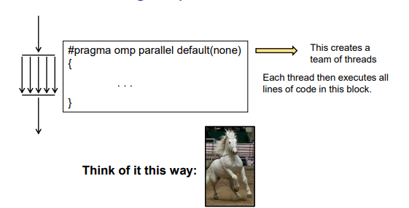
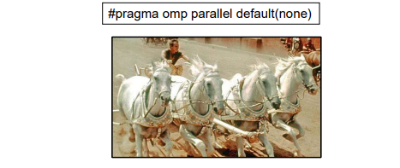
OpenMP: parallel regions

Slide 11
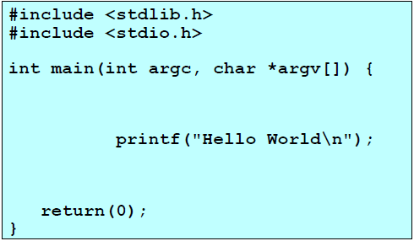
“Hello Word” Example/1

Slide 12
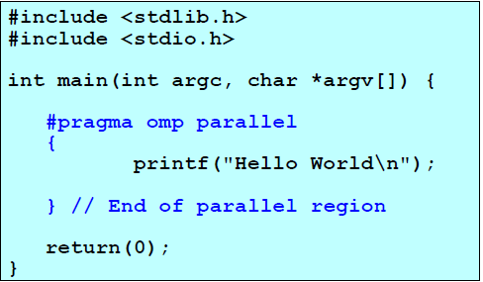
“Hello Word” Example/2

Slide 13
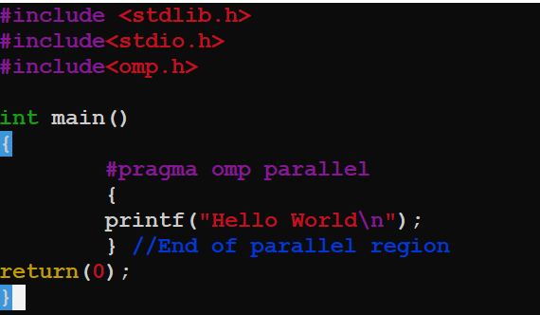
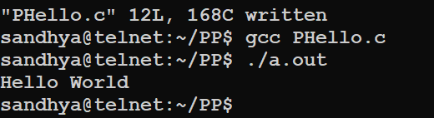
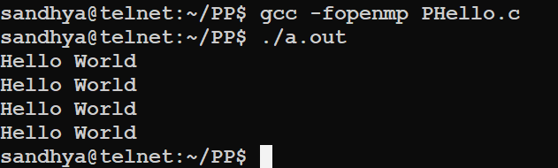
“Hello Word” Example/2

Slide 14
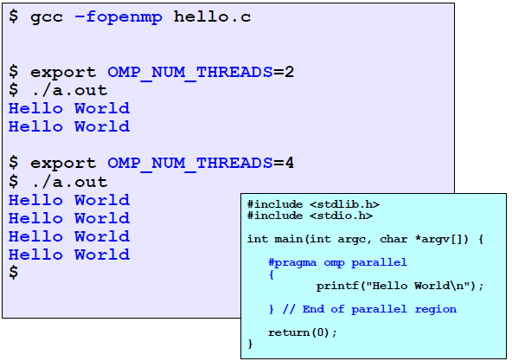
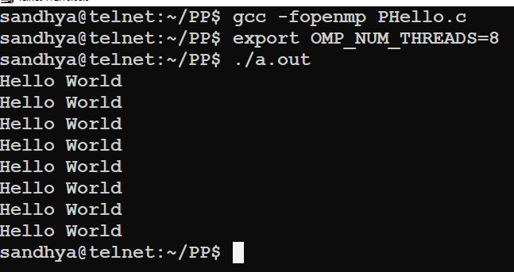
“Hello Word” Example/2

Slide 15
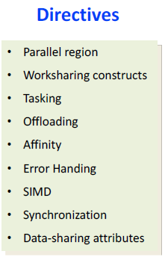
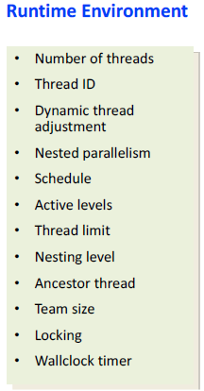
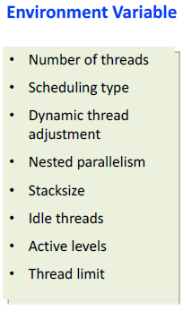
OpenMP Components

Slide 16
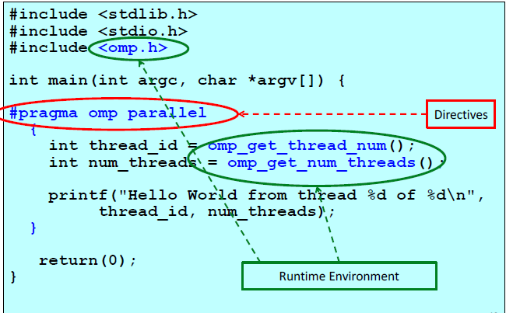
“Hello Word” Example/3

Slide 17
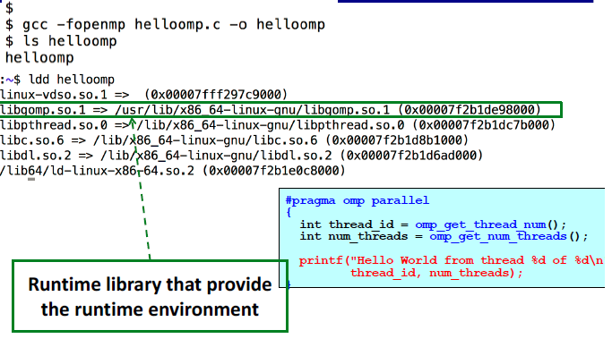
“Hello Word” Example/3

Slide 18
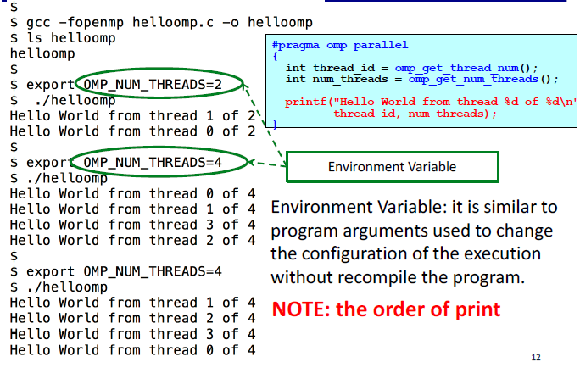
“Hello Word” Example/3

Slide 19
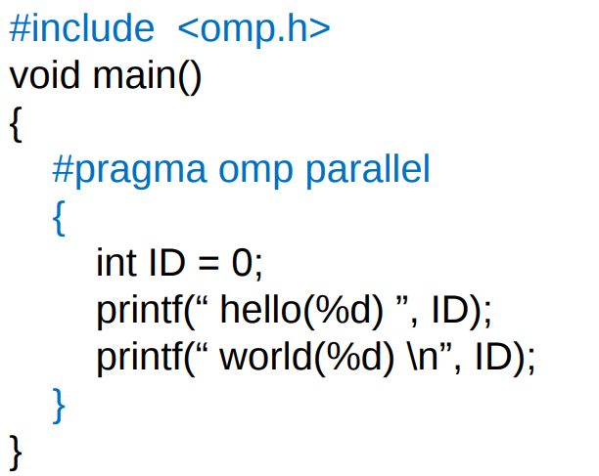
Hello World in OpenMP

Slide 20
OpenMP controlling number of threads
Once a program is compiled, the number of threads can be controlled using the following shell variables
At the program level, via the omp_set_number_threads function:
void omp_set_num_threads(int n)
• At the pragma level, via the num_threads clause:
#pragma omp parallel num_threads(numThreads)

Slide 21
OpenMP controlling number of threads
Asking how many cores this program has access to:
num = omp_get_num_procs( );
Setting the number of available threads to the exact number of cores available:
omp_set_num_threads( omp_get_num_procs( ) );
Asking how many OpenMP threads this program is using right now:
num = omp_get_num_threads( );
Asking which thread number this one is:
me = omp_get_thread_num( )

Slide 22
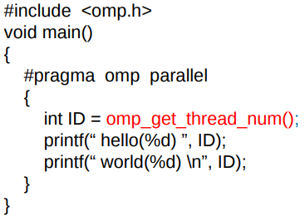
Hello World in OpenMP
Each thread has a unique integer “id”; master thread has “id” 0
Other threads have “id” 1, 2, …
OpenMP runtime function
omp_get_thread_num()
returns a thread’s unique “id”.
What will be the programs output?

Slide 23
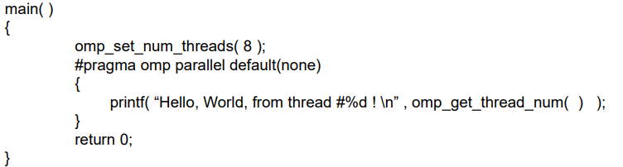
A sample OpenMP program

Slide 24
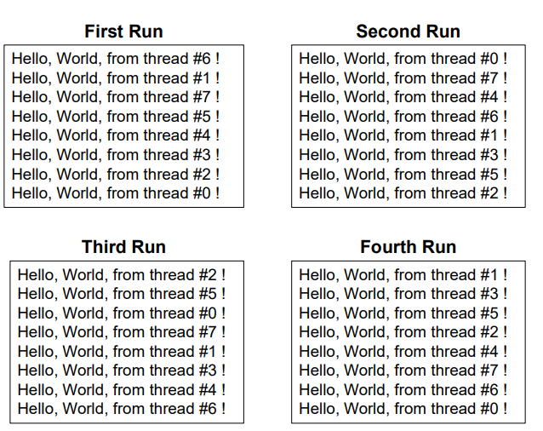
A sample OpenMP program

Slide 25
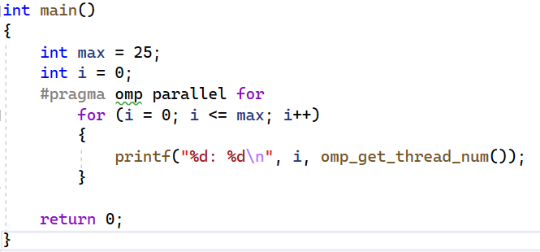
OpenMP: parallel loops
The omp parallel for directive in line 5 specifies that the for loop must be executed in parallel
The iterations of the for loop will be divided among the threads
Once all iterations have been executed, all threads in the team are synchronized at the implicit barrier at the end of the parallel for loop
All slave threads are terminated
Finally, the execution proceeds sequentially, and the master thread terminates the program by executing return 0

Slide 26
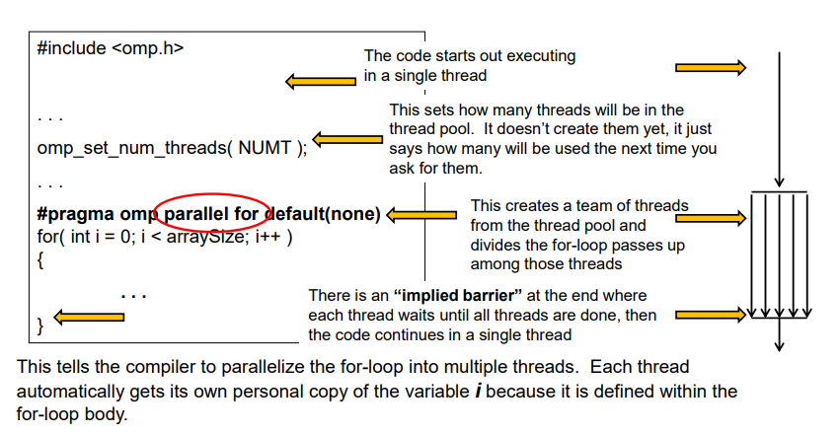
Creating OpenMP threads in Loops

Slide 27
OpenMP: parallel loops
The loop variable is made private to each thread in the team and must be either (unsigned) integer or a pointer
The loop variable should not be modified during the execution of any iteration
The condition in the for loop must be a simple relational expression
The increment in the for loop must specify a change by constant additive expression
The number of iterations of all associated loops must be known before the start of the outermost for loop

Slide 28
OpenMP: parallel loops
The start and terminate conditions must have compatible types
Neither the start nor the terminate conditions can be changed during the execution of the loop
The index can only be modified by the changed expression (i.e., not modified inside the loop itself)
You cannot use a break or a goto to get out of the loop
There can be no inter-loop data dependencies such as:
A[i]=a[i-1]+1;

Slide 29
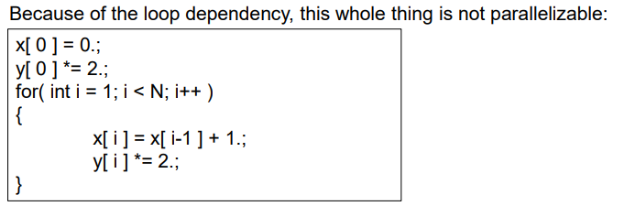
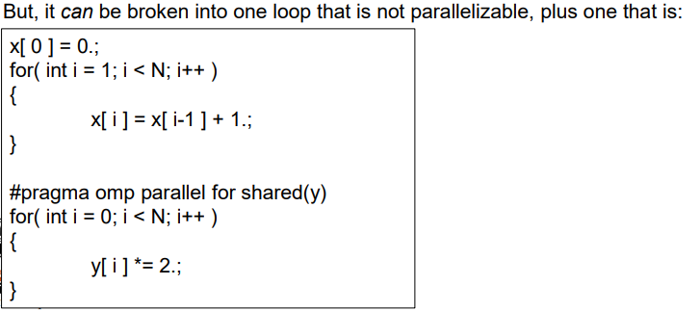
OpenMP: parallel loops

Slide 30
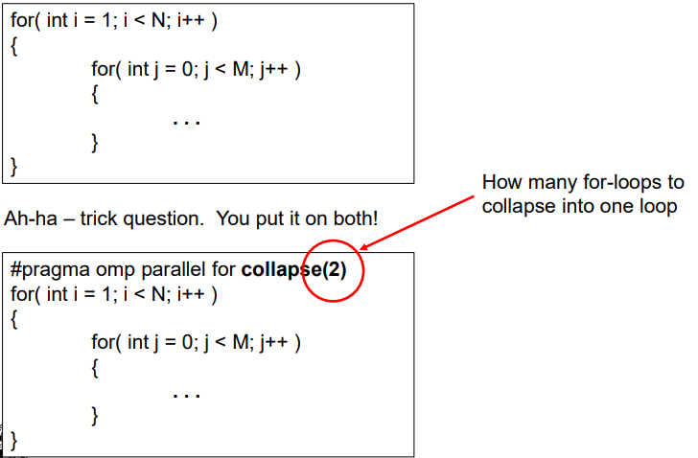
OpenMP: parallel loops

Slide 31
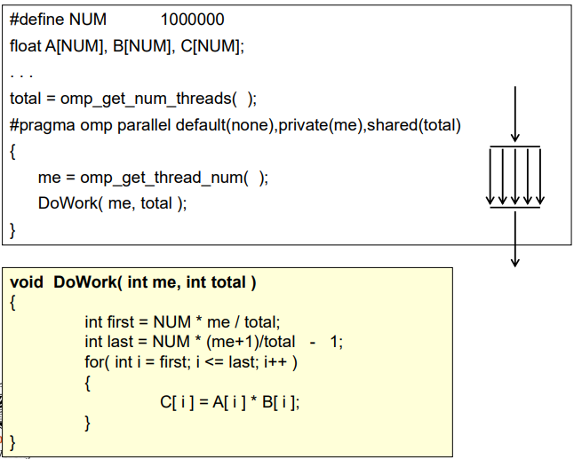
Single Program Multiple Data (SPMD) in OpenMP

Slide 32
OpenMP: data sharing
Various data sharing clauses might be used in omp parallel directive to specify whether and how data are shared among threads:
shared(list) specifies that each variable in the list is shared by all threads in a team, i.e., all threads share the same copy of the variable
private(list) specifies that each variable in the list is private to each thread in a team, i.e., each thread has its own local copy of the variable
firstprivate(list) is like private but each variable listed is initialized with the value it contained when the parallel region was encountered
lastprivate(list) is like private but when the parallel region ends each variable listed is updated with its final value within the parallel region

Slide 33
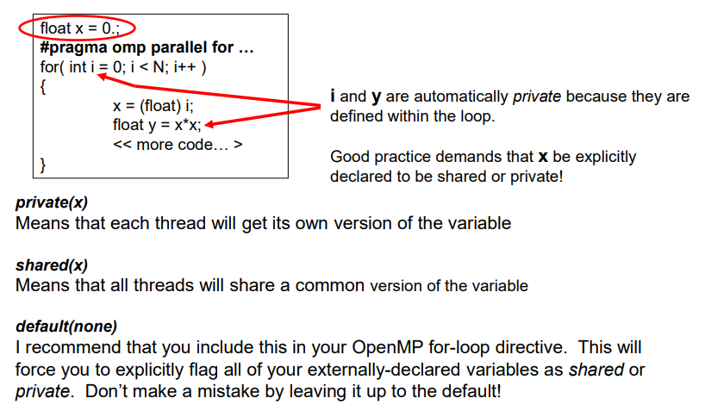
OpenMP: data sharing

Slide 34
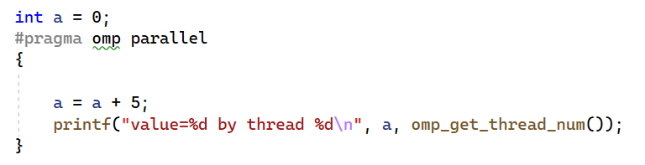
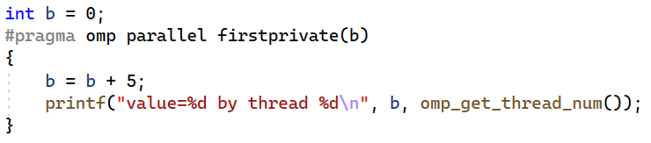
OpenMP: data sharing
If not specified otherwise,
automatic variables declared outside a parallel construct are shared by default
automatic variables declared within a parallel construct are private
static and dynamically allocated variables are shared

Slide 35
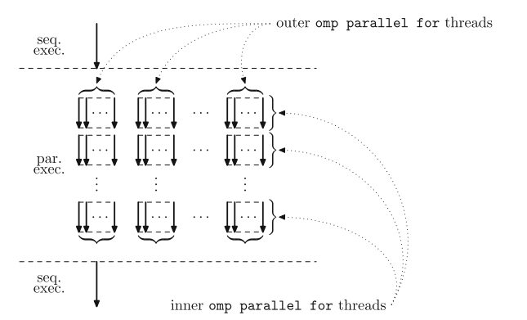
OpenMP: nested parallelism
Nested parallelism is enabled or disabled by setting the shell variable OMP_NESTED nested
where nested is either true or false
Within a program, this can be achieved usign the following two functions
void omp_set_nested(int nested)
Enables or disables nested parallelism
int omp_get_nested()
Tells whether nested parallelism is enabled or disabled.

